Slide 1





Fusing Speed Index during Web Page Loading
ACM SIGMETRICS / IFIP PERFORMANCE 2022
Mumbai, India
June 6-10, 2022
Wei Liu , Xinlei Yang, Hao Lin, Zhenhua Li, Feng Qian
Notes:
Hello everyone. I’m Wei Liu from Tsinghua University. Today I will be talking about our work on making web pages load faster by fusing Speed Index during web page loading.

Slide 2
Outline
Background
Motivation
Design
Evaluation
Conclusion
Notes:
Here is the outline of my presentation, and I will first introduce the background.

Slide 3
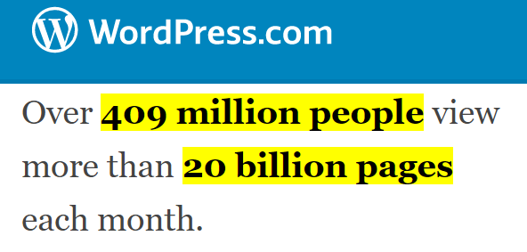
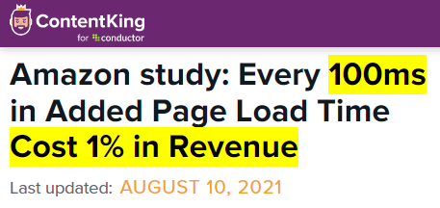

1. Background
Web page load performance is important
Notes:
Web pages have become the most pervasive method for common web users to access Internet services.
According to the data from WordPress in twenty twenty-two (2022), in each month over four hundred and nine (409) million people visit more than twenty (20) billion pages.
As a result, the performance of web page loading is crucial to users’ quality of experience.
A study from Amazon has shown that every one hundred (100) millisecond increase in page load time costs one percent (1%) of their revenue.

Slide 4

1. Background
Metrics to evaluate page load performance
  Conventional metrics
  Page Load Time (PLT)
  Time to First/Largest Paint
  Time to Interactive
Notes:
So evaluating web page performance is important.
And that’s why many page load metrics have been proposed to measure page load speed.
For example, Page Load Time measures the duration between the timepoint when the user starts to navigate to the page, and the timepoint when all of the web objects have been fetched and evaluated.
However, as web pages become more and more dynamic and complex, these conventional metrics are being blamed for deviating from the actual user experience.
This is because most of them simply focus on the milestone events during page loading, rather than the entire page loading process.

Slide 5
1. Background
More advanced metrics
  Above-the-Fold Time (AFT)
  Object Index
  Byte Index
  Speed Index (SI)
  More...
Notes:
To this end, in recent years more advanced web page performance metrics are proposed to overcome the drawbacks of the conventional metrics, such as Above-the-Fold Time, Object Index, Byte Index, and Speed Index.
Among them, Speed Index has been widely used in both industry and academia to meticulously measure the users’ quality of experience.

Slide 6






1. Background
Speed Index (SI)
  How fast the page is filled up with the above-the-fold visible elements (i.e., crucial elements)
Above-the-Fold
A
Below-the-Fold
B
500 ms
1200 ms
3000 ms
Notes:
Speed Index quantifies how quickly the page is filled up with the above-the-fold visible elements, and we call them crucial elements.
Above the fold here refers to the content the user sees before they scroll down the page.
We take an example of two page load processes A and B of bbc.com to illustrate what Speed Index actually measures.
As shown in the figure, loading process A and B have the same Page Load Time of three (3) seconds.
However, in loading process A, large crucial elements are loaded first and therefore, at one point two (1.2) seconds, more visible areas of the page have been populated.
This gives us a feeling that the page with loading process A is loaded faster than B, even though they have the same Page load time.

Slide 7
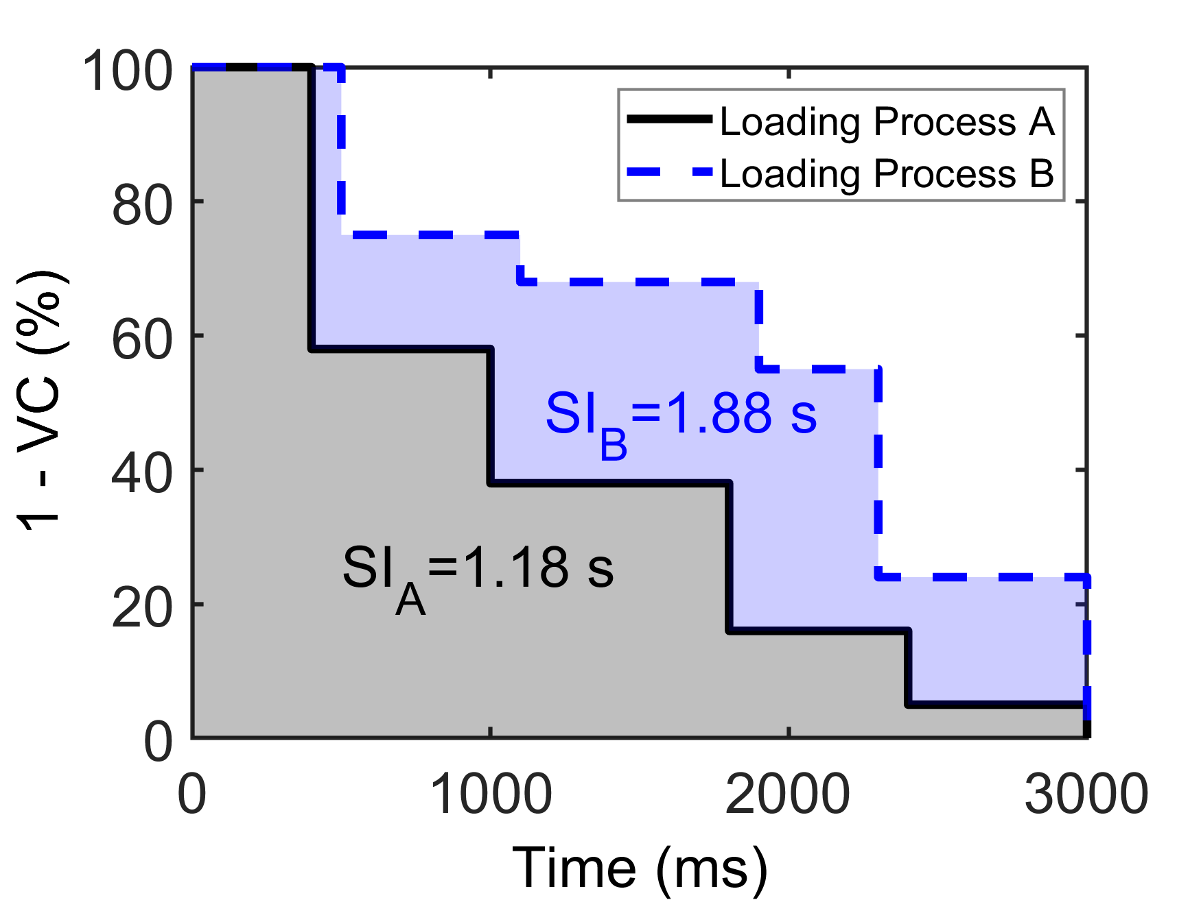
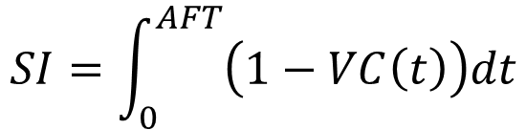
1. Background
Formal definition of SI
AFT: Above-the-Fold Time
VC(t): Visual Completeness of the page’s above-the-fold section at time t
$$SI=\int_{0}^{AFT}{\left(1−VC\left(t\right)\right)dt}$$
A
B
500 ms
1200 ms
3000 ms
Notes:
The formal definition of Speed Index is the integral of unrendered percentage of above-the-fold section, from the time when the page begins to load, to the above-the-fold time.
In the previous example, the visual completeness of the loading process A is higher than B at any time, so its unrendered percentage of the above-the-fold section is lower, thus leading to a smaller Speed Index.
That’s to say, a smaller Speed Index indicates a better page load from the user's subjective perspective.

Slide 8
2. Motivation
SI is being used retrospectively after page loading
  Acting as a passive performance metric due to:
  Integral calculation
  Requiring the final rendered frame
“Fusing” SI into page loading
  Proactively taking SI as an explicit heuristic to guide page loading in situ.
  In this way, we might be able to effectively improve SI of page loads.
Notes:
As a more reasonable and advanced web page performance metric, Speed Index is still being used retrospectively to measure the goodness of web page loading schemes after page loading.
This is not surprising because the calculation of Speed Index is rather complicated.
First, it involves the integral calculation, because it tracks the entire loading process.
Second, it requires the final rendered frame of the page for visual completeness calculation.
However, if there does exist a feasible approach to fusing SI during web page loading, we might be able to know the best SI one can achieve, or at least effectively improve SI by re-architecting today’s web server and client design.
In other words, our goal is to achieve or closely approach SI-optimal page load scheduling.
We want to schedule the fetching and evaluation of web page objects by explicitly and proactively taking SI into account.

Slide 9
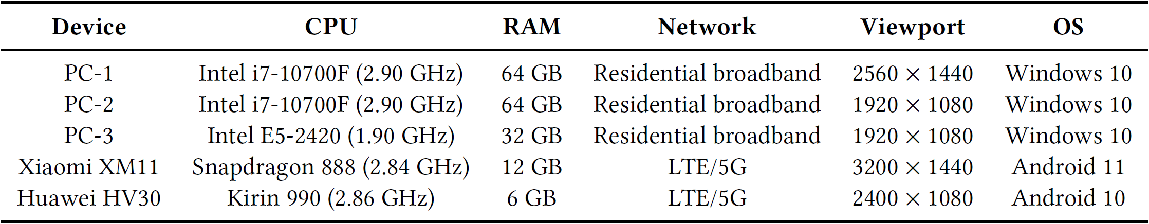
2. Motivation
Measurement study
  Landing pages of the Alexa top 1,000 sites
  3 PCs, 2 mobile phones
  Collecting network/rendering traces, snapshots, etc.
Notes:
To explore whether there exists a practical approach to proactively exploiting SI as guidance to page load scheduling, we start with a comprehensive measurement study on the Alexa top one thousand (1,000) sites.

Slide 10
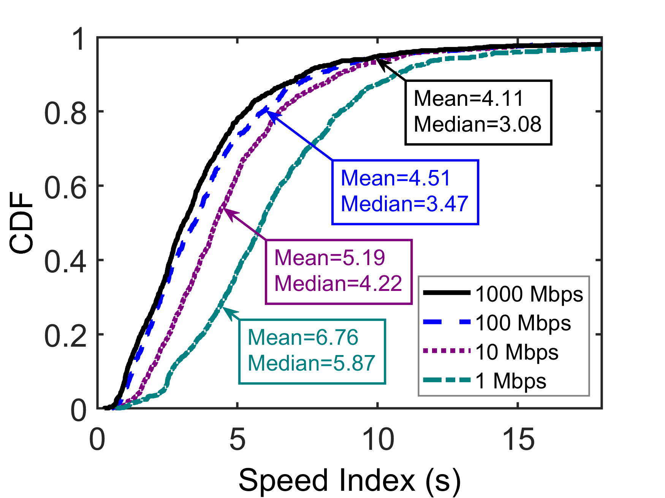
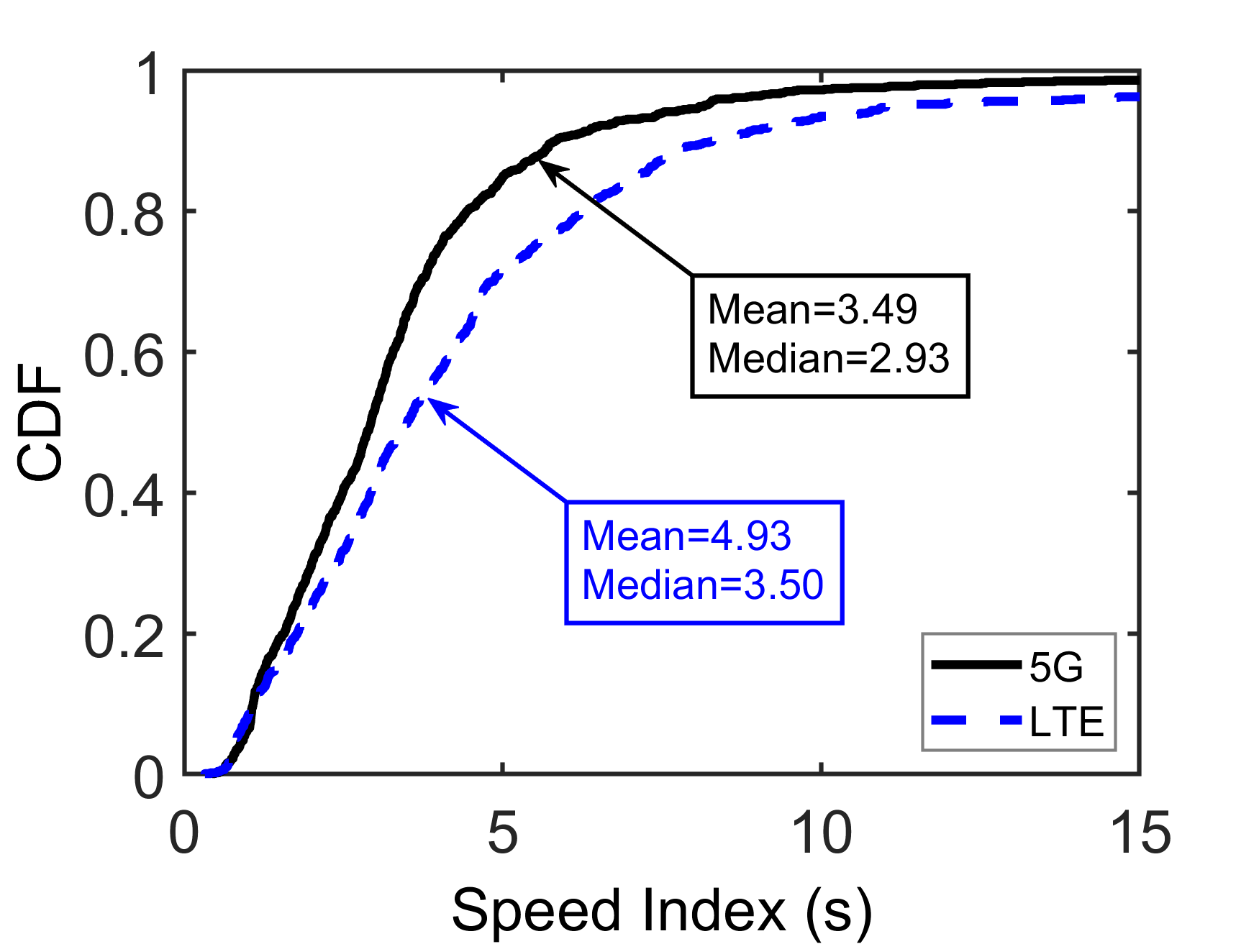
2. Measurement Findings
Network uncertainties
  Different network access methods
  Bandwidth/latency variation
Notes:
Here are our major findings.
First, we find that the Speed Index of page loading varies with the network uncertainties.
Usually, a higher bandwidth and lower latency can result in a better SI.
However, we also observe that benefits of better network conditions on SI cannot persist.
When the network condition is good enough, the Speed Index tends to converge to a certain value.
This indicates that the bottleneck of page loading may switch to some other factors.

Slide 11
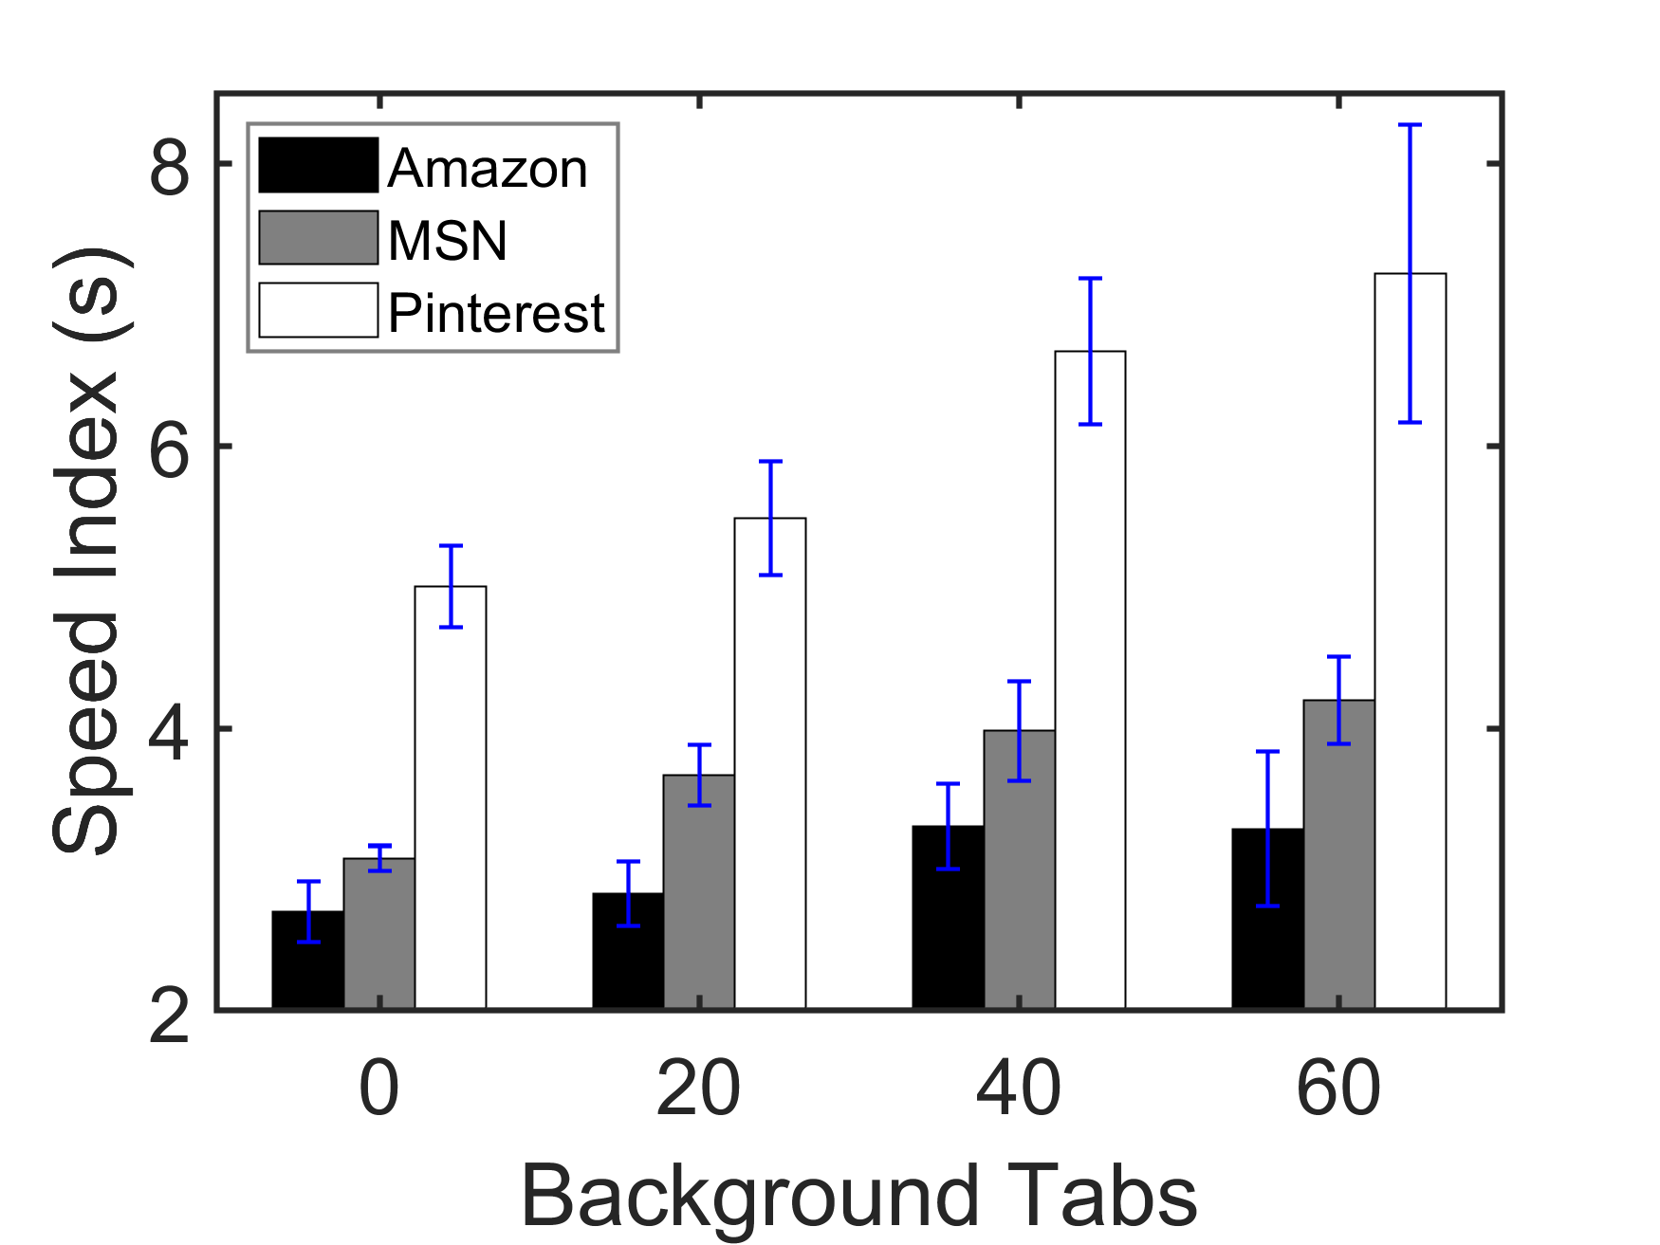
2. Measurement Findings
Browser execution uncertainties
  Client resource contention
  Varied number of background tabs opened by users
Notes:
Second, Speed Index can be affected by the browser execution uncertainties.
Client resource contention among different processes affects browser execution performance.
Also, when users open more page tabs at the same time, the computation and memory resources allocated to each page decrease.
This results in a worse Speed Index.

Slide 12
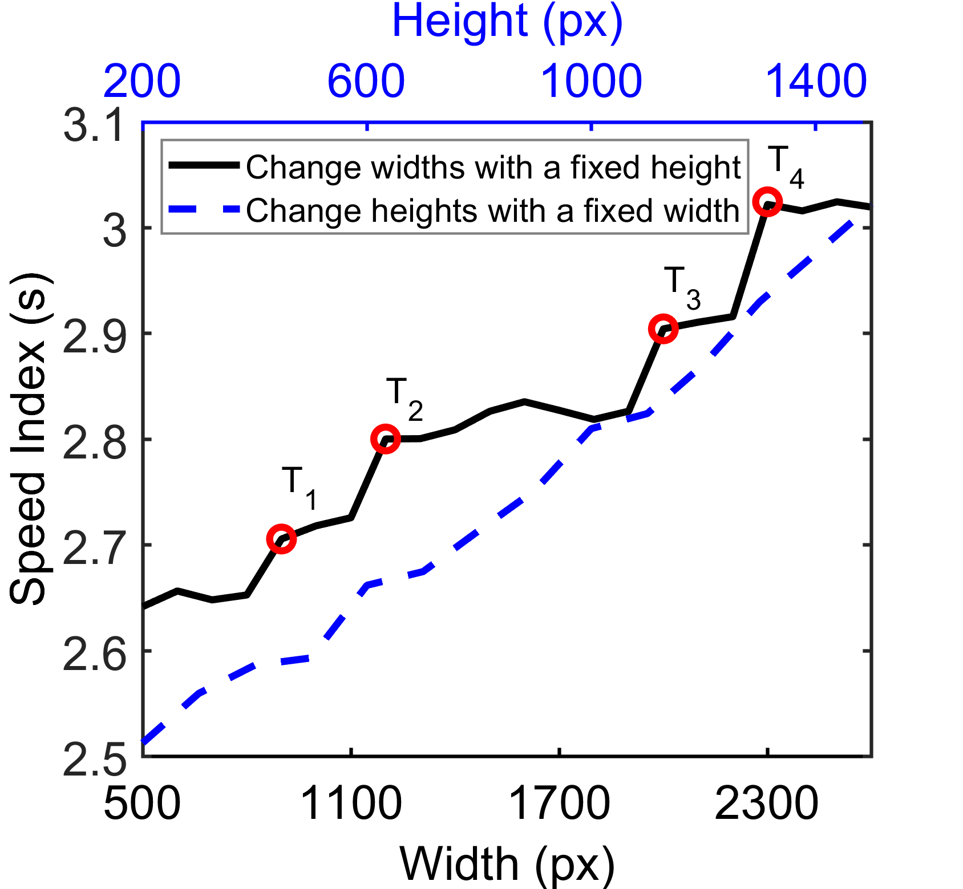



2. Measurement Findings
Viewport size uncertainties
  Diverse viewport sizes v.s. liquid layouts
width=500 px
width=872 px
width=1128 px
  Different layout schemes of YouTube
Notes:
Third, Speed Index can be affected by client-side viewport sizes.
More surprisingly, the Speed Index of different web pages change differently when the user viewport size changes.
This is because many today's web pages adopt liquid layout (or the responsive layout) for adapting the web page contents to different viewport sizes.

Slide 13
2. Motivation
Our Goal Obtaining SI-optimal scheduling
Network
Uncertainties
Browser Execution
Uncertainties
Viewport Size
Uncertainties
Obstacles
  SI-optimal scheduling cannot be achieved in advance or in one shot!
Dilemma
Question
How to handle uncertainties of web page loading?
Notes:
To sum up, through our measurement study, we observe that there exist three fundamental uncertainties, which are network uncertainties, browser execution uncertainties, and user-side viewport size uncertainties, that significantly hinder us from obtaining SI-optimal page load scheduling.
Due to these uncertainties, it is impossible to achieve the SI-optimal scheduling in advance or in one shot.
Therefore, we intend to seek for a feasible approach to handling these uncertainties and achieving the SI-optimal page load scheduling in a progressive manner.

Slide 14
3. SipLoader
Reactive scheduling
  Adapting to web page loading
  Create a baseline scheduling (SI-optimal if no uncertainties)
  Adjust to different viewport sizes (identify crucial elements)
  Repair the baseline when uncertainties occur
“Reactive scheduling does not try to cope with uncertainty in creating the baseline schedule but revises or re-optimizes the baseline schedule when an unexpected event occurs.”
Notes:
Through a comprehensive survey of literature, we seek out a promising framework from operational research, called reactive scheduling.
Reactive scheduling is dedicated to tackling a variety of scheduling uncertainties in a progressive manner, so as to minimize their negative impact and achieve near-optimal performance.
To be more specific, reactive scheduling does not try to cope with uncertainty in creating the baseline schedule but revises or re-optimizes the baseline schedule when an unexpected event occurs.
We apply reactive scheduling to web page load optimization in three steps.
First, we create a baseline scheduling for loading the web page objects.
Such a baseline scheduling is anticipated to be SI-optimal if there were no upcoming uncertainties.
When creating the baseline scheduling, we should adjust to the different viewport sizes, by identifying crucial elements.
Third, when uncertainties actually occur, we reactively repair the baseline scheduling to recover the near optimality of the scheduling in real time.

Slide 15
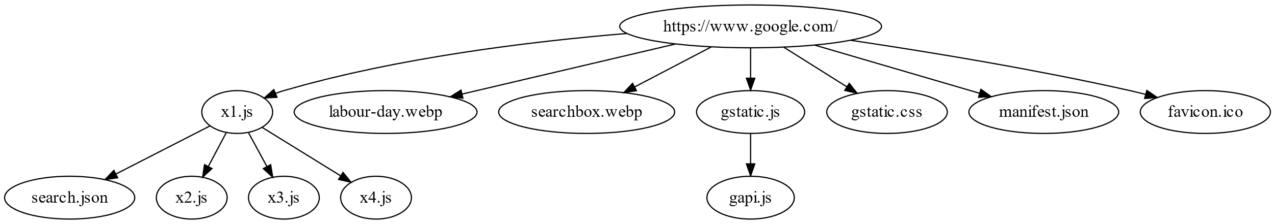
3.1 Creating the Baseline
Dependency-merged greedy inference
  Page loading should obey dependencies
  Modeled as a dependency graph
In which order should we load objects to achieve SI-optimal scheduling?
Notes:
When landing reactive scheduling framework onto web page loading, the key challenge lies in efficiency.
In fact, the loading process of a web page should obey complex dependencies among web page objects.
For example, a script may read or write variables defined by other scripts, or invoke the functions defined in other scripts.
Such dependency relations during page loading among web page objects can be modeled as a dependency graph, which is a directed acyclic graph.
So, the problem of how to create the baseline scheduling is equal to in which order we should load these web page objects so that the page loading is SI-optimal without violating the dependency.

Slide 16
3.1 Creating the Baseline
Dependency-merged greedy inference
  Each web page object
  Incurs time overhead to load (Loading cost)
  Contributes to the visual completeness (SI gain)
SI gain (%) / Loading cost (ms)
A, B, C, D, E, F, G
A, C, B, D, E, F, G
A, D, B, C, E, F, G
…
Topological sort-based approach
is too slow – O(n!)
Notes:
Generally, each web page object incurs time to load, and we call it, the loading cost, and contributes to the visual completeness during page loading, and we call it the SI gain.
These can all be estimated by pre-loading the web page.
Let's take this dependency graph as an example.
Each node shows the loading cost and the SI gain of a web object.
So now we wonder in which order should we load these objects such that the shadowed area in the figure at the upper right corner is minimal so as to achieve the optimal SI.
A simple solution is first list all the valid loading orders that obey the dependency using topological sort algorithm, and then for each valid loading order we calculate its Speed Index based on the SI gain and loading cost information, and finally we choose the minimal one as the baseline scheduling.
Unfortunately, such an approach is too inefficient since it bears a time complexity of O N factorial.
In fact, we have proved that this problem is NP-Complete via a reduction from the single-machine precedence-constrained job sequencing problem.
Detailed proof can be found in our paper.

Slide 17
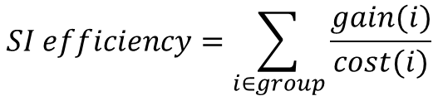

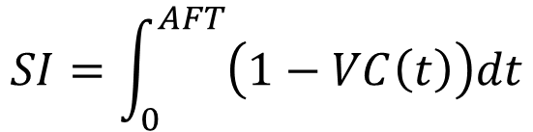
3.1 Creating the Baseline
Dependency-merged greedy inference
  Near-optimal solution
  Heuristic: the cumulative nature of SI calculation
$$SI=\int_{0}^{AFT}{\left(1−VC\left(t\right)\right)dt}$$
$$SI efficiency=\sum_{i∈group}{\frac{gain(i)}{cost(i)}}$$
$$SI efficiency=\frac{gain}{cost}$$
Object group of F
Notes:
We then resort to a near-optimal solution to creating the baseline scheduling.
We begin with a simple case.
Suppose that there are no dependencies among web page objects.
At this time, loading these objects according to the decreasing order of (𝑆𝐼 𝑔𝑎𝑖𝑛)/(𝐿𝑜𝑎𝑑𝑖𝑛𝑔 𝑐𝑜𝑠𝑡) can achieve SI-optimal scheduling.
We denote such division as SI efficiency.
When there exist dependencies among web page objects, the SI efficiency of each object comes to the overall efficiency of its precedent dependencies and the object itself, because loading a certain object must load all of its precedent dependencies first.
We denote precedent dependencies of an object with the object itself as an object group.
The shadowed nodes in the graph belong the object group of F.
So the overall SI efficiency of the object group is calculated as dividing the sum of SI gain of each object by the sum of the loading cost of each object given the cumulative nature of SI calculation.
We repeatedly select the object that has the highest SI efficiency to load, and remove it from and update the dependency graph.
In this way, we can quickly generate the near-optimal baseline scheduling by taking advantage of cumulative nature of SI calculation.

Slide 18
3.2 Identifying Crucial Elements
Predictive element region forest
  How to adjust to different viewport sizes efficiently?
Liquid layout Crucial elements are uncertain until the page is loaded!
Preload the page
Elements’ possible positions
Query crucial elements
Server
Client
Server-client collaboration
Notes:
Now we introduce how to determine crucial elements for the SI gain calculation.
As we mentioned before, crucial elements are the above-the-fold visible elements.
But they are uncertain until the page is fully loaded owing to the liquid layout used by many pages.
We employ a server-client collaboration scheme to overcome this.
The server first pre-loads the page to determine elements’ possible positions under different viewport configurations in an offline manner.
Such possible positions will be sent to the client along with the top-level HTML so that the client can efficiently query crucial elements at the beginning of page loading.

Slide 19
3.2 Identifying Crucial Elements
Predictive element region forest
  Determine elements’ possible positions:
  Layout scheme might change when the viewport width changes
width=500 px
width=872 px
width=1128 px
  Different layout schemes of YouTube
Notes:
To determine the elements’ possible positions under different viewport sizes, we first need to identify all the layout schemes used by the page.
This is because elements’ positions under different layout schemes can vary greatly, while under the same scheme, the position only changes slightly.
Take the landing page of YouTube as an example, when the layout scheme changes, some elements become visible, but in the same scheme, changes are only limited in element sizes.

Slide 20


3.2 Identifying Crucial Elements
Predictive element region forest
  Identify layout schemes based on relative angles (server-side)
width=1400 px
width=1080 px
Notes:
We identify each layout scheme of a web page based on our key observation that the relative positions between elements does not change substantially in the same layout scheme.

Slide 21



3.2 Identifying Crucial Elements
Predictive element region forest
  Identify layout schemes based on relative angles (server-side)
$$α_{2}=22°$$
$$β_{2}=22°$$
$$γ_{2}=90°$$
width=1400 px
width=1080 px
Relative angles change slightly under the same layout scheme
Notes:
For example, when the viewport width decreases from 1400 pixels to 1080 pixels, the Starbucks web page stays in the same layout scheme.
And the relative positions between each elements only change slightly.
We identify a new layout scheme when the average relative anlages between each two elements changes more than a certain threshold compared with the previous page load with a smaller viewport width.

Slide 22
3.2 Identifying Crucial Elements
Predictive element region forest
  Element coverage regions (possible positions) in each layout scheme
Record element coverage regions when the viewport width changes
(server-side)
Notes:
After all the layout schemes are identified, we record the element coverage regions in each layout scheme when the viewport width changes every 50 pixels.
This is achieved by recording all the coordinates of the element under each viewport width.

Slide 23
3.2 Identifying Crucial Elements
Predictive element region forest
Build regions’ convex hulls into k-d trees (for each layout scheme)
The client selects and efficiently queries a k-d tree based on viewport sizes to identify crucial elements
Notes:
For each identified layout scheme, we then compute the convex hulls of each elements’ coverage regions and build the convex hull points into a k-dimensional tree.
We call this data structure as predictive element region forest.
This data will be sent along with the page’s top-level of HTML to the client at the beginning of page loading for the client to efficiently query crucial elements.

Slide 24
3. SipLoader
The cumulative reactive scheduling framework
Creating the baseline schedule
Online repairing
Leverage the cumulative nature of SI calculation
React to the occurrence of uncertainties
Notes:
So far, we have efficiently created a baseline scheduling before page loading in a server-client collaboration manner.
It is worth noting that we take advantage of the cumulative nature of SI calculation to address the efficiency issue of applying traditional reactive scheduling to web page loading.
Therefore, we call this novel scheduling framework cumulative reactive scheduling framework.
Based on this, we implement Siploader, an SI-oriented page load scheduler.

Slide 25
3. SipLoader
The cumulative reactive scheduling framework
Creating the baseline schedule
Online repairing
Leverage the cumulative nature of SI calculation
React to the occurrence of uncertainties
Notes:
We next switch to the online repairing phase of the framework for SipLoader to react to the uncertainties.

Slide 26
3.3 Repairing the Baseline
Event-driven reactive co-scheduling
  Repair the baseline scheduling
  React to network/browser execution uncertainties
  In an event-driven manner
Network fetches
Browser execution
Notes:
To effectively deal with the uncertainties, SipLoader continuously monitors the events generated by the network stack as well as JavaScript and Rendering engine.
If the network slots are available, SipLoader initiates requests based on the baseline scheduling order.
If the JavaScript engine or rendering engine finish evaluating an object, SipLoader will then select an unevaluated object to evaluate.
This object is headmost in the baseline SI-optimal scheduling and has no precedent dependencies.
In this way, the fetched object can be evaluated as quickly as possible without waiting for the object that has a higher priority but is delayed by the uncertainties.

Slide 27
4. Evaluation
Comparing with state-of-the-arts
  Vroom [SIGCOMM’17]: Server-aided dependency resolution
  Fawkes [NSDI’20]: Static template caching
Testbed
  Landing pages of random 300 sites in the Alexa top 1,000 list
  Network: {1, 10, 100} Mbps, {10, 25, 50, 75} ms latency
  Browser: Cold cache, warm cache
  Device: PC, mobile phone
Notes:
We evaluate the performance of SipLoader by comparing it with two state-of-the-art web page accelerators, Vroom and Fawkes.
Vroom employs a server-aided dependency resolution scheme to speed up page loads.
Fawkes enables faster page loads through HTML template caching.

Slide 28
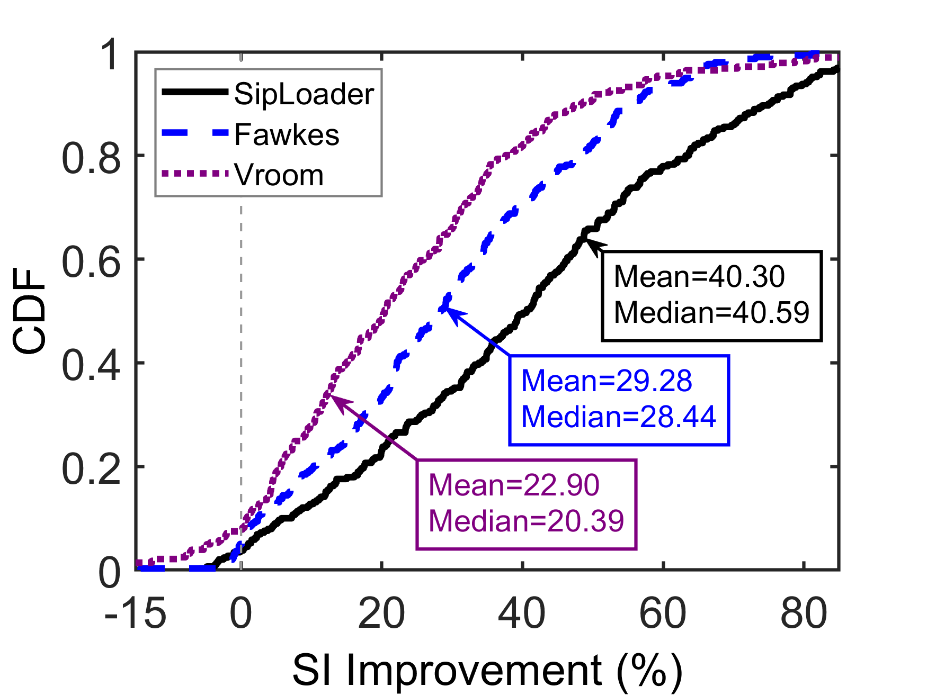
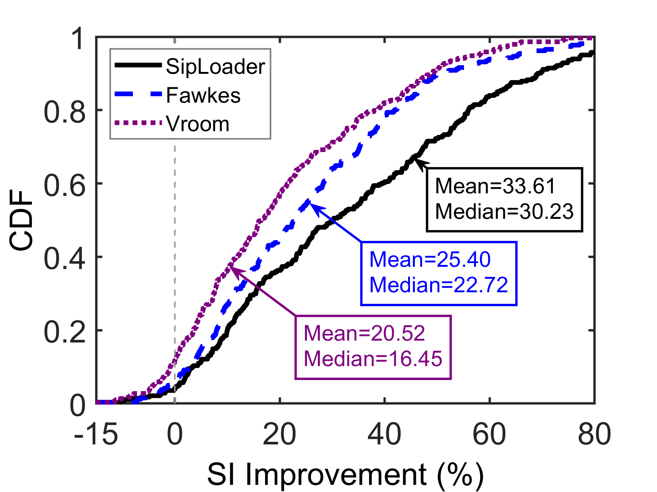
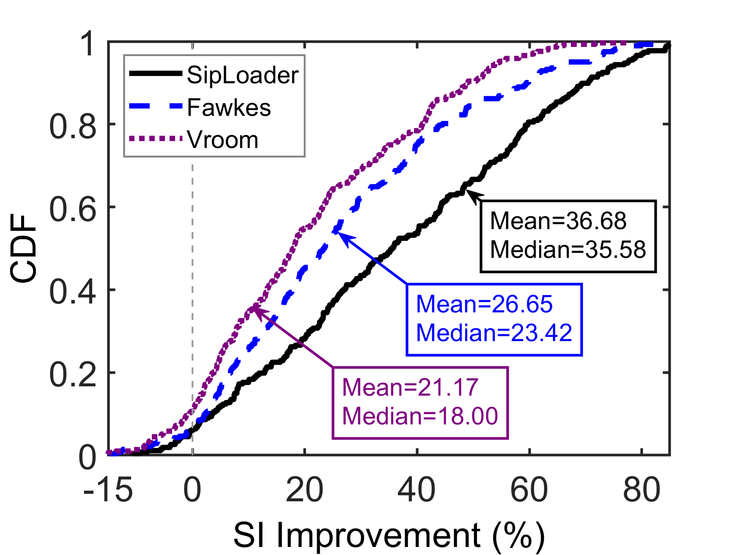
4. Evaluation
Major results
  Cold cache: Improve SI by more than 30%
10 Mbps, 25 ms latency, 2.4 GHz
100 Mbps, 25 ms latency, 2.4 GHz
100 Mbps, 25 ms latency, 1.9 GHz
It is important to schedule object loading when network/computation resources are limited!
Notes:
Here are our major results.
First, in the cold cache scenario, SipLoader improves the median Speed Index by over 30%, significantly outperforming the other two accelerators.
Also, when the network condition or the clients-side computation power is poor, SipLoader yields more remarkable SI improvement.
This indicates that it is important to well schedule object loading sequence especially when network/computation resources are limited.

Slide 29
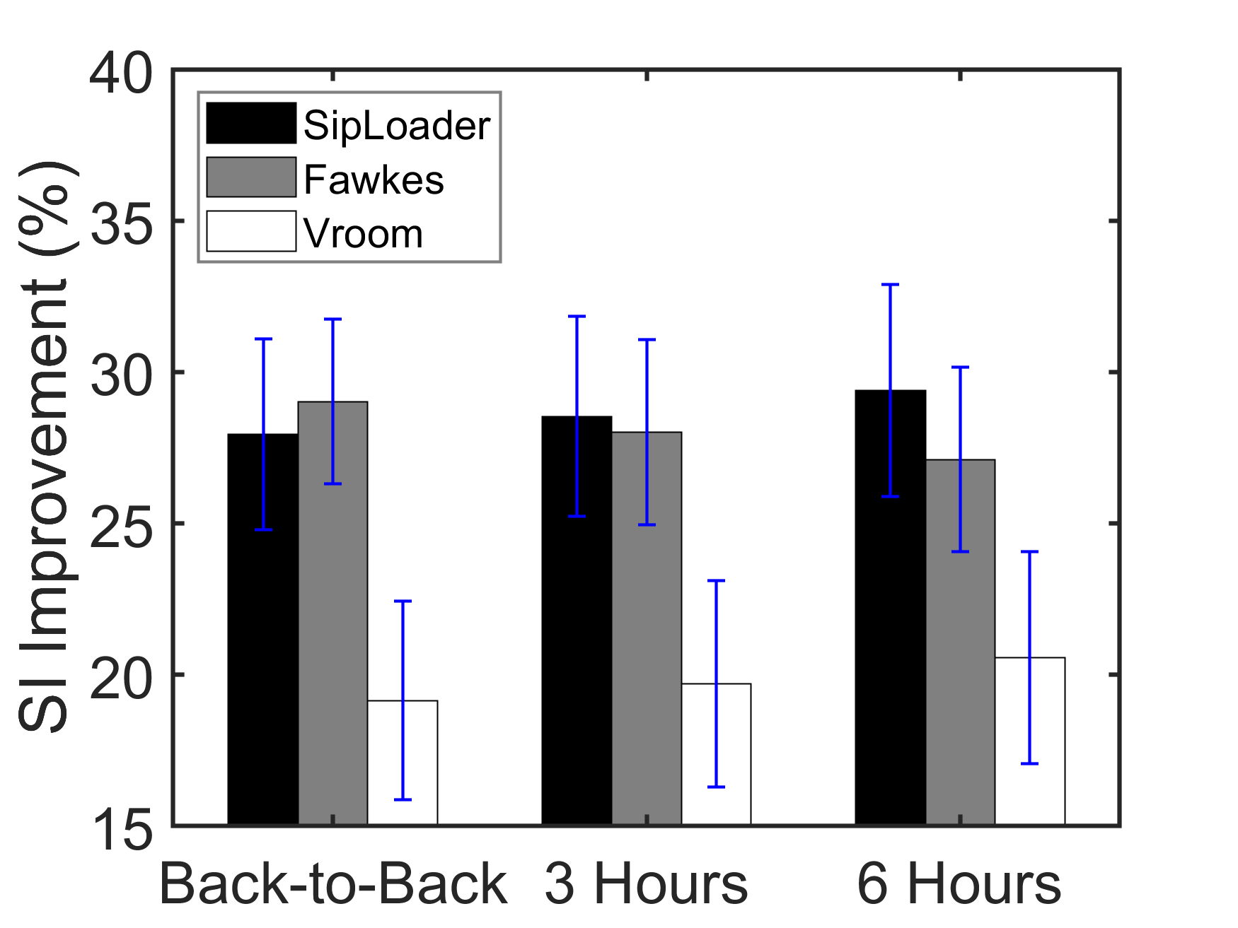
4. Evaluation
Major results
  Warm cache
SipLoader schedules both network fetches and browser execution to achieve the (near-)optimal SI
Browser execution bottleneck
Network/browser execution bottleneck
Notes:
When it comes to the warm cache scenario, SipLoader can still significantly benefit the SI of page loading process.
This is because, SipLoader schedules both network fetches and browser execution.
This enables it to improve Speed Index either when the browser execution is the bottleneck, or when network is the bottleneck.

Slide 30
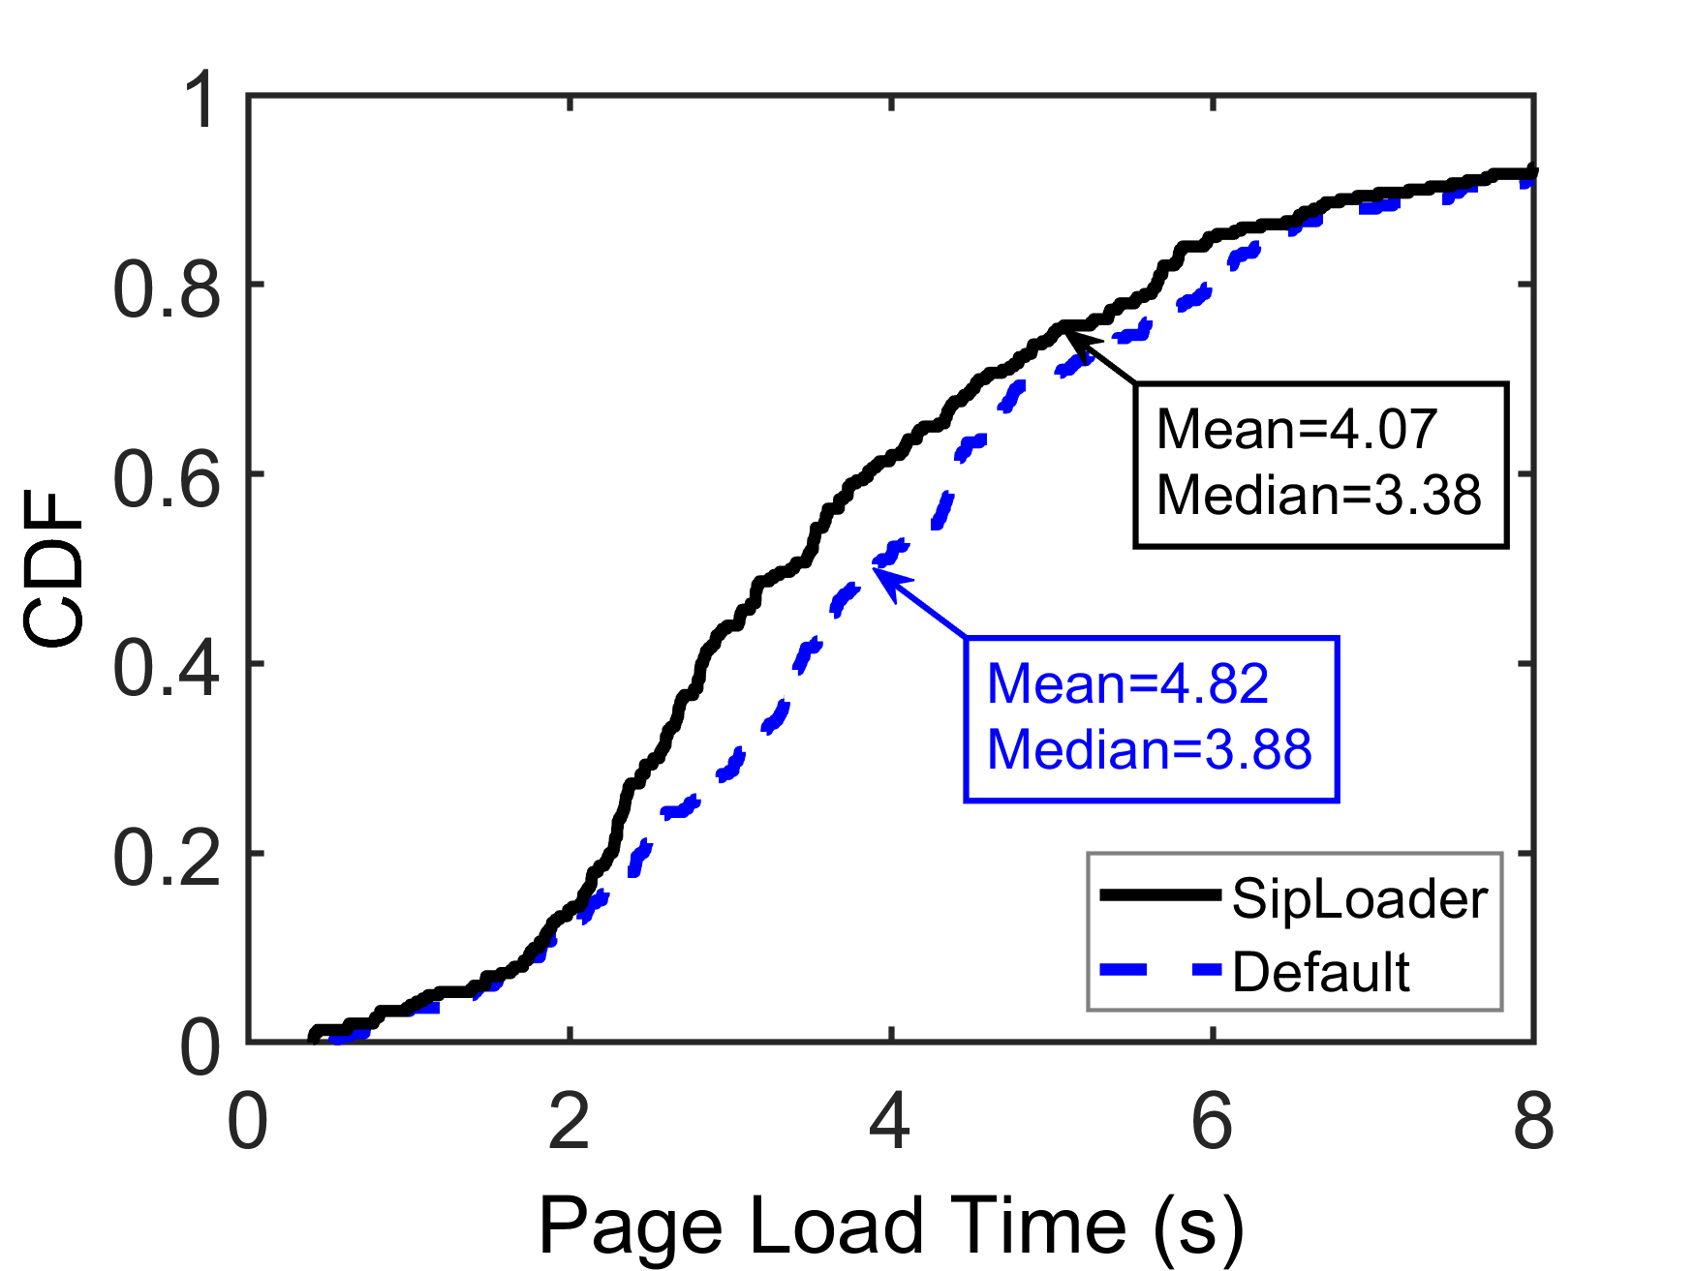
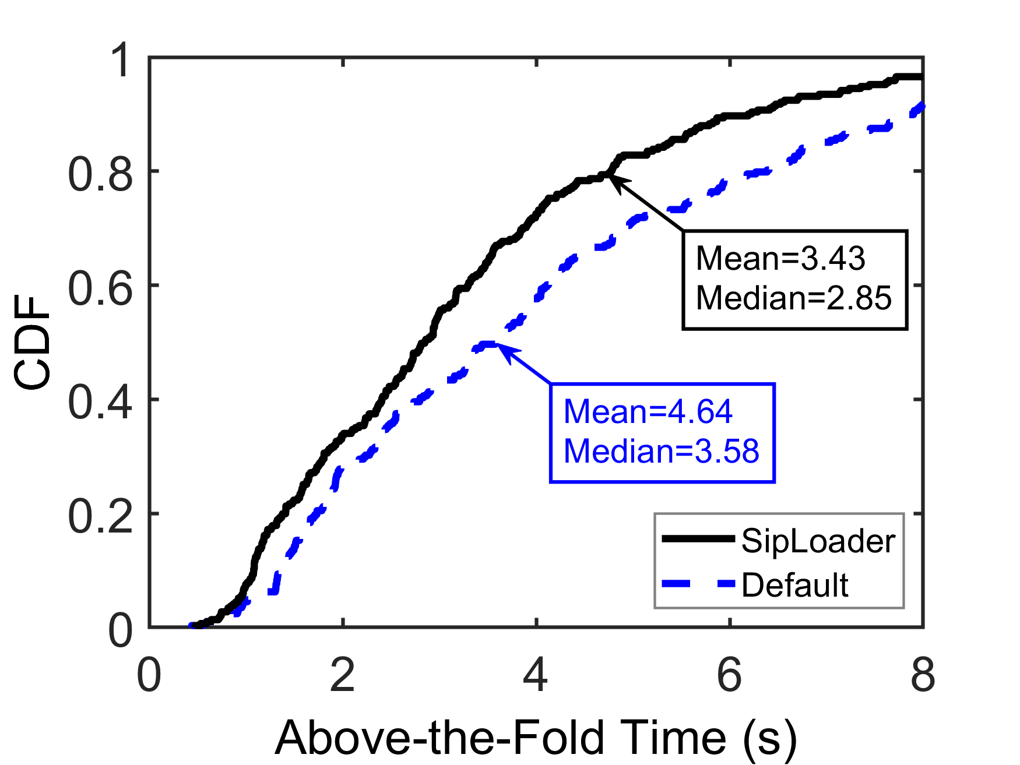
4. Evaluation
Beyond SI
  SipLoader also improves other metrics
Dependency graph is generated in advance
Crucial elements have higher priorities
Notes:
In addition to Speed Index, SipLoader improves the page load performance measured by other metrics such as Page Load Time and above-the-fold time.
This is because the dependency graph is generated in advance and crucial elements have higher priorities to be rendered.

Slide 31
5. Conclusion
We uncover the key challenge of using advanced web page performance metrics (such as Speed Index) to guide page loading – the uncertainties during page loading make it impossible to obtain the optimal scheduling in advance or in one shot.
We present SipLoader, an SI-oriented page load scheduler that leverages the cumulative reactive scheduling framework. It does not deal with uncertainties in advance, but repairs the baseline scheduling when uncertainties actually occur. SipLoader improves the average SI by 33.6%.
Source code and data are available at https://siploader.github.io/
Thanks!
Q & A
Notes:
In this paper, we build an effective page load scheduler called SipLoader, which successfully addresses the uncertainties during page loading through the novel cumulative reactive scheduling framework, and thus proactively uses SI to enhance the page loading performance.
Code and data have all been released.
That’s all.
Thanks for your listening.

